Slide 1
Introduction to the Issues (Osborne:10 min)
General Whitefly Information (Mannion:20 min)
Whitefly Management
Chemical Control
• Landscape Invasives, Pros & Cons of Neonicitinoids (Mannion:25 min)
• Production, Including Resistance Management Guide (Osborne:10 min)
Biological Control (Osborne:15 min)
Current Research & Grant Update
• Biocontrol Efforts - FDACS-DPI Facilitated Grant (Osborne:15 min)
• Efforts of Post-Doc & Key Biscayne & Palm Beach Gardens Trials (Mannion:15 min)
Questions and Discussion (10 min)
Outreach & Resources
• FLWHITEFLY Website (Stocks15 min)
• Palm Beach Working Group (Schall:15 min)
• Florida’s View & Boxstore Issues (Dixon:20 min)
Questions, Discussion & Conclusion (All presenters: 10 min)
Adjourn
Notes:
Introduction to the Issues, Lance Osborne (10 minutes)
General Whitefly Information (20 minutes)
• _Basic Info & Whitefly Species of Concern (biology, hosts, etc.) Catharine Mannion, PHD
• _Questions and Discussion
Whitefly Management
Chemical Control
• _Landscape Invasives, Pros & Cons of Neonicitinoids Catharine Mannion (25 minutes)
• _Production, Including Resistance Management Guide
Lance Osborne, PhD (10 minutes)
Biological Control, Lance Osborne (15 minutes)
Current Research & Grant Update
• _Biocontrol Efforts, Grant Info, Trevor Efforts
Lance Osborne (15 minutes)
• _Efforts of Post-Doc & Key Biscayne & Palm Beach Gardens Trials, Catharine Mannion (15 minutes)
Questions and Discussion (10 minutes)
Outreach & Resources
• _FLWHITEFLY Website, Stephanie Stocks (15 minutes)
• _Palm Beach Working Group, Bill Schall (15 minutes)
• _Florida’s View & Boxstore Issues, Wayne Dixon, PhD (20 minutes)
Questions, Discussion & Conclusion, Lance Osborne & All presenters (10 minutes)
Adjourn

Slide 2
WHITEFLY IST

Slide 3
ORGANIZERS EILEEN BUSS CATHARINE MANNION LANCE OSBORNE BILL SCHALL

Slide 4
INVASIVE WHITEFLIES
A new pest can impact many commodities.
A new pest impacts production systems not just a host plant – not in a vacuum.
Solutions require cooperation between Regulators, Industries, Scientists and the Public.

Slide 5
OLD IMPORTED
WHITEFLIES
Aleurodicus dugesii
Bemisia tabaci B-biotype
Bemisia tabaci Q-biotype
Notes:
MEALYBUGS
Phenacoccus multicerarii
Hypogeococcus pungens - CA, FL, HI, PR Harrisia Cactus Mealybug (HCM), NPAG
Nipaecoccus viridis – FL Lebbeck Mealybug
Planococcus minor - FL, HI Passionvine Mealybug
Palmicultor palmarum
Pseudococcus elisae

Slide 6
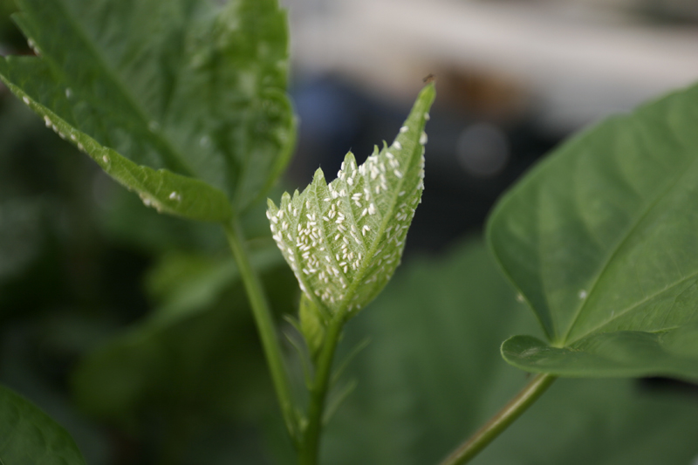
Bemisia

Slide 7
Significance
Of Bemisia
Major economic losses
Jobs lost
People displaced
Contributes to Famine and even death in Africa

Slide 8
Misuse of pesticides threatens the long-term viability and sustainability of the ornamental industry
ISSUES

Slide 9
Off Label uses
ISSUES
Distributors selling ag products for use on ornamentals.
People knowing this is an illegal practice but willfully applying them!

Slide 10
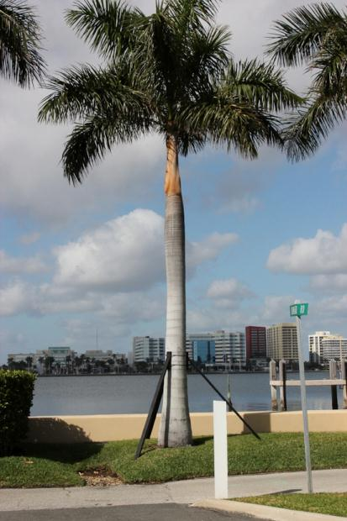
POTENTIAL CONTAMINATION
ISSUES

Slide 11
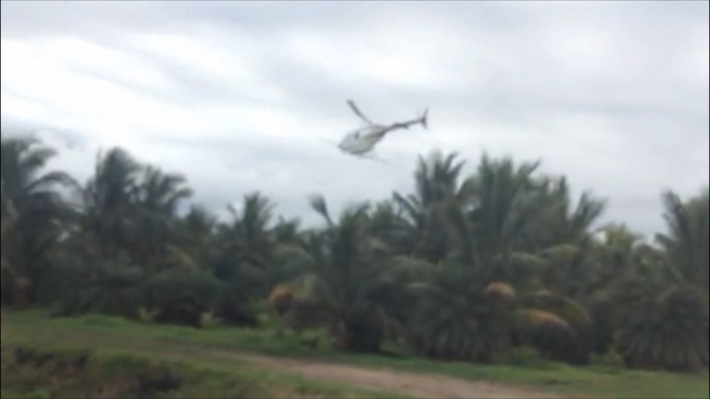
POTENTIAL CONTAMINATION
ISSUES

Slide 12
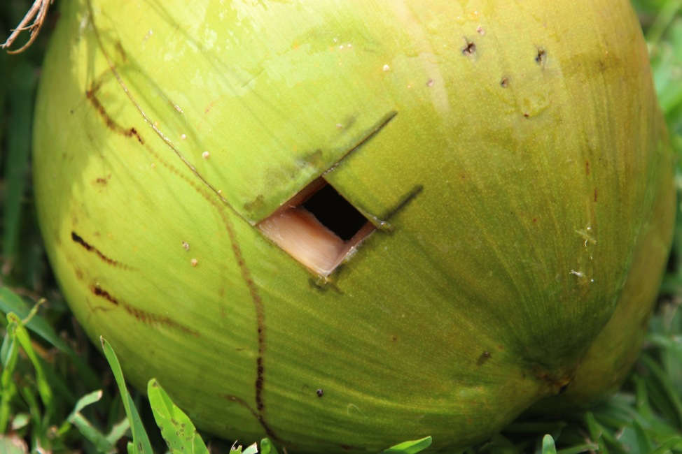
Treated Coconuts NOT Harvested
ISSUES
Before people consume them.

Slide 13
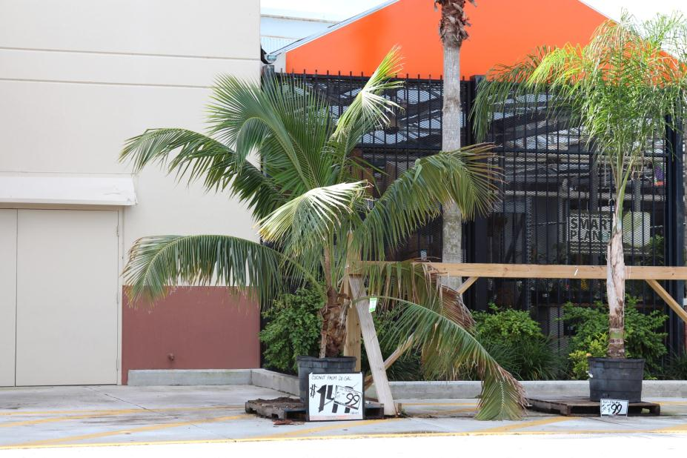
Box Stores: Friend or Foe?
ISSUES

Slide 14
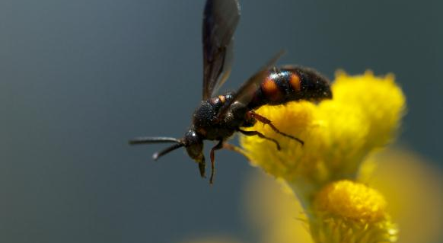
Pollinators
ISSUES

Slide 15
Solutions
Communication
Education
Cooperation
Applied Research
Systems Approach
Our Strengths

Slide 16
Thank you!
RESEARCH SUPPORTED BY:
Notes:
28 ai
12 moa
3 unknown moa

